Slide 1

Amazon Cognito
Presentation by:
S.Suresh
CloudSIKSHA

Slide 2
Cognito
Amazon Cognito provides authentication, authorization, and user management for your web and mobile apps
Your users can sign in directly with a user name and password, or through a third party such as Facebook, Amazon, or Google
User Pools and Identity Pools

Slide 3

User Pools
A user pool is a user directory in Amazon Cognito
Sign-up and sign-in services. Authenticated and Unauthenticated identities
A built-in, customizable web UI to sign in users.
Social sign-in with Facebook, Google, and Login with Amazon, and through SAML and OIDC identity providers from your user pool.
User directory management and user profiles.
Security features such as multi-factor authentication (MFA), checks for compromised credentials, account takeover protection, and phone and email verification.

Slide 4

Identity Pools
With an identity pool, your users can obtain temporary AWS credentials to access AWS services, such as Amazon S3 and DynamoDB
Identity pools support anonymous guest users, as well as the following identity providers that you can use to authenticate users for identity pools:
Amazon Cognito user pools
Social sign-in with Facebook, Google, and Login with Amazon
OpenID Connect (OIDC) providers
SAML identity providers
Developer authenticated identities

Slide 5
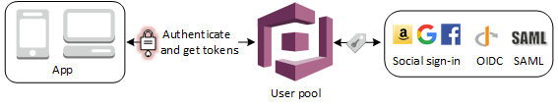
Authenticate With User Pool

Slide 6
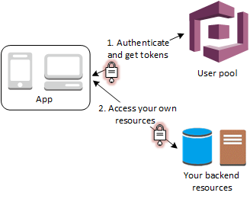
Access Server Side Resource

Slide 7
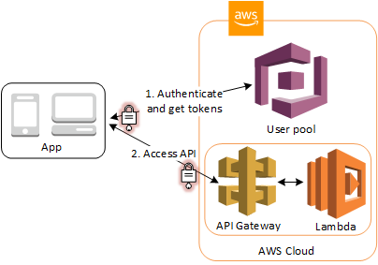
Access API Gateway and Lambda

Slide 8
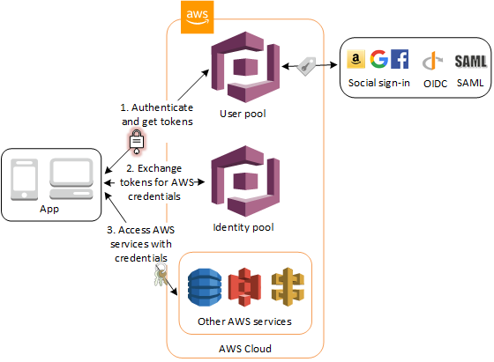
Access AWS Services

Slide 9
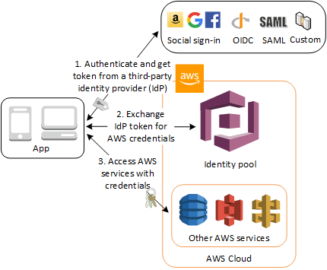
Authenticate with Third Party

Slide 10
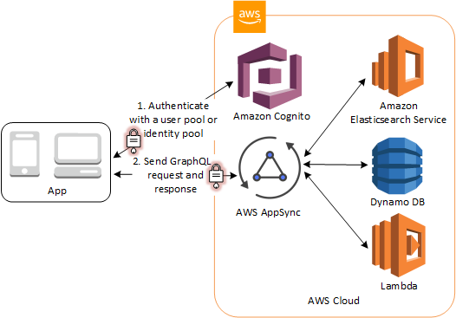
Access AppSync Resources

Slide 11

Thank you

